Slide 1
Student engagement in articulation
Hannah Clarke
Development Advisor

Slide 2
sparqs
Student Participation in Quality Scotland
Funded by the Scottish Funding Council since 2003 to support students and institutions by:
Supporting students to engage in enhancing their education.
Supporting institutions and students’ associations to develop effective student engagement mechanisms and practices.
Supporting student engagement in national policy initiatives.
Supporting the development of a culture of student engagement across Scotland.
Notes:
Ensure students are able to engage as partners in all levels of assurance and enhancement activities including:
Commenting on and shaping their own learning experience.
Taking an active part in formal student engagement mechanisms, including quality processes and strategic decision making
Shaping the development of the student experience at national level.

Slide 3
Our Vision
Students making a positive and rewarding difference to their own and others’ educational experience, helping shape the nature of learning and contributing to the overall success of Scotland’s universities and colleges.

Slide 5
A Student Engagement Framework for Scotland
There are five key elements:
Students feeling part of a supportive institution.
Students engaging in their own learning.
Students working with their institution in shaping the direction of learning.
Formal mechanisms for quality and governance.
Influencing the student experience at national level.
The use of the term ‘learning’ throughout the framework can apply to learning, teaching and assessment.
Notes:
1. Providing services that help students initially engage with and continue to feel part of a supportive institution.
2. Students engaging in their own learning
3. Students commenting on and shaping the direction of learning.
4. Formal student engagement mechanisms, quality and governance.
5. Engagement in shaping the student experience at a national level.

Slide 6
A Student Engagement Framework for Scotland
There are six features of effective student engagement:
A culture of engagement.
Students as partners.
Responding to diversity.
Valuing the student contribution.
Focus on enhancement and change.
Appropriate resources and support.
Notes:
Principles and Values -
1. Widely owned culture.
2. Partnership.
3. Meeting Diverse needs.
4. Recognising and rewarding student contribution.
5. Has to be about Enhancement and change.
6. Resourced and supported.

Slide 7
Why is student engagement important?
Student
views
Dialogue
with staff
Improved learning
experience
Students are experts in their learning
Notes:
Come together as partners – with staff as experts in teaching subject, course organisation etc.
And students experts in their learning – i.e. they know what’s in their heads, they know how much they’ve leaned from their courses and they know about what has affected how much they have learned.
When they come together – dialogue with staff – there is an improved learning experience for everyone.
Students who are studying a course are the only ones who truly understand what the learning experience is like and are therefore the only ones who can provide accurate positive and negative feedback - they are the experts!
Now run through the diagram:
Students provide expert views on the learning experience.
They then enter a dialogue with staff, who have their own expertise in how the learning is delivered as well as subject specific knowledge.
This results in an improved learning experience for the students.

Slide 8
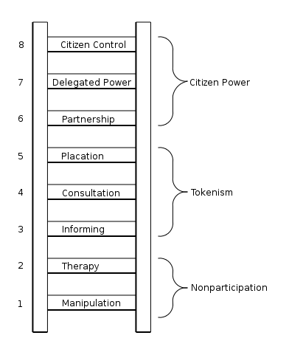
Ladder of participation (Arnstein 1969)

Slide 9
partner
expert
authentic & constructive dialogue
actor
recognised as experts in learning
information provider
collector & analyst of feedback
a completer of surveys

Slide 10
How does this relate to articulation? In two ways…

Slide 11
How are decisions taken which affect students?
How can students influence those decisions?

Slide 12
Student engagement in articulation activity
College and university staff will frequently make decisions which affect articulating students
This could be on an interpersonal level, in formal committees, and could be on a unconscious level

Slide 13
Issues which affect articulating students
There will be specific issues which affect students who have articulated from college but may not affect others.
Think about -
How these issues are identified.
How they are dealt with.
Is there collaboration between the college and university?
How do we engage students across the transition boundary?
Notes:
Students need to be aware of what student engagement means for them and how it will improve their overall experience
Correct conditions need to be in place (policies, processes, buy-in) so that students can effectively engage
How can staff can encourage and inform students throughout their entire student journey?
Students may need support to effectively reflect upon their learning in order to be able to comment on it successfully
Student engagement can mean different things to different people - achieving student engagement won’t necessarily be the same for all
How do we get the most out of student engagement both at the individual and representative level?
Past successes or failures with students can have an impact on how staff view student engagement
Difficulty in attracting students to take on representative roles and maintaining student engagement

Slide 14
How are decisions taken which affect students?
How can students influence those decisions?
Notes:
Are the right conditions in place for individual student engagement – policies, procedures, opportunities?
Are different types of opportunities for engagement available for different types of students?
Do students have the correct information or knowledge to be effectively engaged?
Is the timing of engagement right?
Are students building on their engagement experience and having the opportunity to develop as co-creators or active learners?

Slide 15
Exercise 1 (15 mins)
In groups, split the flipchart in two.
On the left write down the 3 key ways in which articulating students are engaged at your institution.
On the right, write down ideas for how they could be engaged further, and the kind of support required to do it.

Slide 16
Exercise 2 (15 mins)
This time -
On the left write down the potential benefits of student engagement for articulating students.
On the right write down the possible benefits of student engagement for staff/your institution.

Slide 17
sparqs and ELRAH work
Aims –
To ensure that the student voice is heard in decisions made about articulation in the region.
To facilitate better student engagement across transition boundaries.

Slide 18
Student Group
What do you think?
What opportunities does this group present?
What are the challenges?
Would this work in your area/for your hub?

Slide 19
Lessons learned
Students are experts in their learning – this makes them a valuable resource!
If students are able to shape their education, this should lead to the best educational outcomes.
You make decisions which affect students – so involve students in them!
Some issues affect articulating students more, so they may need to be engaged separately.

Slide 20
Thanks for taking part!
If you are interested in finding out more about sparqs or our project with ELRAH please contact -
Hannah.Clarke@sparqs.ac.uk www.sparqs.ac.uk

